Slide 1
SOME TOURISM POTENTIALS IN KRACHI WEST
INTRODUCTION
Tourism is generally considered as one of the main forces of economic growth especially in least developed economics. In Ghana, tourism is said to be the fourth largest source of foreign income after cocoa, gold and oil. Krachi West District has a strong tourism potential yet to be fully developed for it to contribute its rightful quota to the accelerated development of the district’s economy.

Slide 2
IMPORTANCE OF TOURISM TO THE DEVELOPMENT OF LOCAL ECONOMICS
Tourism contribute to the development of the local economics in so many ways. These includes;
Tourism boosts the revenue of the economy
Tourism creates thousands of jobs to the local people
Tourism influence infrastructure development. Eg, Road construction, Provision of quality drinking water and so forth.
Tourism create a sense of cultural exchange/identity/Cultural Assimilation
Tourism promote education
Tourism serves as a source of market/induces more consumption
It enaces foreign exchange

Slide 3
Some challenges affecting tourism
The development of tourism in Krachi West District is affected by numerous factors; These includes;
Lack of support from authority
Inadequate infrastructural. Eg. roads
Lack of accommodation/hospitality facilities such as hotels.
Issues of insecurity
Lack of legal backing for plans. Eg. Issues of land acquisition
Lack of financial resources

Slide 4
THE WAY FORWARD
In order to experience the full contribution of tourism towards the development of our local economics, the following must be observed;
Government should support tourism activities interms of funds and other resources
Provision of infrastructure such as good roads, good drinking water and so forth to the local areas
Provision of adequate accommodation facilities such as hotels, guest houses.
Intensifying security in the various tourist sites
Increase Public Education to enable people to understand the importance of tourism to the development of the local areas.

Slide 5
SOME TOURISM POTENTIALS IN KRACHI WEST DISTRICT
The Volta Lake: The Volta Lake is one of the largest and most significant man made lake which offers employment and food to a large number of people. It offers rich fresh waterfish for consumption, support transportation and so on. Below is a portion of the lake;

Slide 6
THE VOLTA LAKE

Slide 7
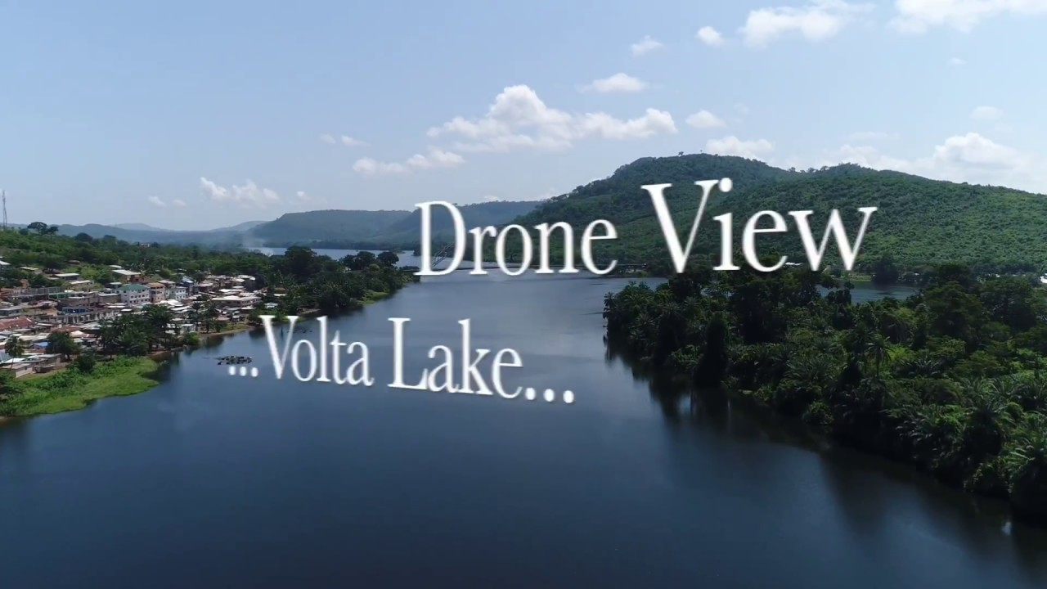

Slide 8
ISLANDS/ISLETS
There are about 40 islands on the volta lake in the Krachi West District. Some are inhabited by people and others are not. The images below some of the Islands

Slide 9
ISLAND

Slide 10
ISLAND

Slide 11
THE OLD KETE-KRACHI SLAVE ROUTE
The old Kete-Krachi, now completely under water except for three buildings including the German barracks, used to be a very important nodal town as well as a slave port in the past. The main north-South slave Caravan Route passed through Kete-Krachi. Slaves from Salaga were ‘’shipped’’ in boats to river ports like Akuse and Ada.

Slide 12
The Slave Market at Salaga

Slide 13
OLD GERMAN BARRACKS
An old office built entirely of local metamorphic rock served as military barracks for the Germans. The building is still in good shape and about 95% of the original structure is still intact.

Slide 14
Images of the Old German Barracks

Slide 15
Old German Barracks

Slide 16
KRACHI DENTE SHRINE
Krachi-Dente Shrine is very popular in West Africa Traditional Religion. The Shrine was moved from its original abode to a new place. Many who are plagued with a sorts of disaseses are said to find cure there.

Slide 17
NANA KRACHI-WURA PALACE
Krachi-Wura palce is the seat of Nana Krachi-Wura as well as his official residence. The palace represents the traditional home of the Chief of Krachi. It is a great tourist site for people especially student from both local or international. Below represent the palace;

Slide 18
Images of the Nana Krachi-Wura Palace

Slide 19
Nana Krachi-Wura Palace

Slide 20
The Ferry
A Ferry is a vessel used to carry passengers, and sometimes vehicles and cargo, across a body of water. The ferry makes transportation on water eassy and accessible.
It is an attractive tourism potential needed to be developed as this may go a long way to generate revenue for the District.

Slide 21
The Ferry

